Slide 1
Eclipse Plug-in Development
Eclipse Plug-in Development Part 2
Editors

Slide 2
Contents
Overview
Editor extension point
org.eclipse.ui.editors
Classes for editor
IEditorPart and EditorPart
IEditorInput
IEditorActionBarContributor and EditorActionBarContributor
Working with editor
Title and ToolTip
Dirty and Save
Opening editor
Multiple page editor
MultiPageEditorPart
MultiPageEditorActionBarContributor
Outline

Slide 3
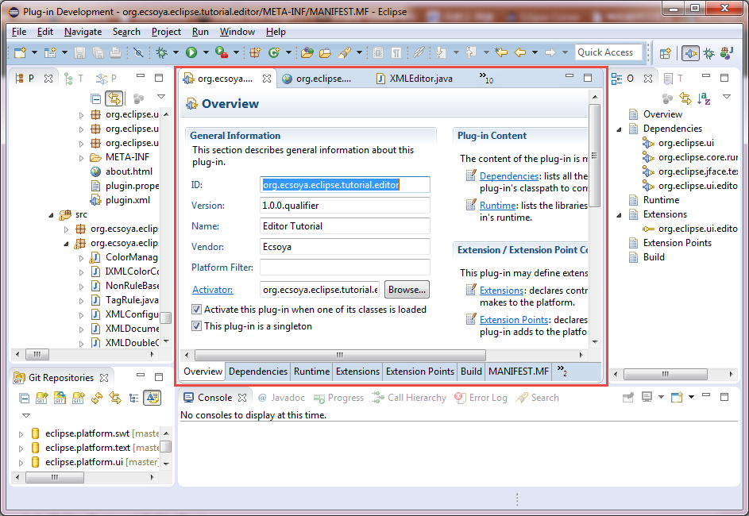
Overview

Slide 4
Editor Extension Point
org.eclipse.ui.editors
id: unique name to identify the editor
name: display name
icon: display icon
extensions: list of file types (separated by “,”)
core:
class: org.eclipse.ui.IEditorPart
contributorClass: org.eclipse.ui.IEditorActionBarContributor
matchingStrategy: org.eclipse.ui.IEditorMatchingStrategy
command: launch an external editor
launcher: org.eclipse.ui.IEditorLauncher
default: default editor or not
filenames: list of file names
symbolicFontName: symbolic name of a font (org.eclipse.ui.fontDefinitions)

Slide 5
Classes for editor
IEditorPart and EditorPart
public class SampleEditor extends EditorPart {
public SampleEditor() {
}
public void doSave(IProgressMonitor monitor) {
}
public void doSaveAs() {
}
public void init(IEditorSite site, IEditorInput input) throws PartInitException {
}
public boolean isDirty() {
return false;
}
public boolean isSaveAsAllowed() {
return false;
}
public void createPartControl(Composite parent) {
}
public void setFocus() {
}
}

Slide 6
IEditorPart
Init()
Verify the input
Save site and input
public void init(IEditorSite site, IEditorInput input) throws PartInitException {
if (!(input instanceof IFileEditorInput)) {
throw new PartInitException("Invalid Input: Must be IFileEditorInput");
}
setSite(site);
setInput(input);
}

Slide 7
IEditorPart
Contents
public void createPartControl(Composite parent) {
control = new Composite(parent, SWT.NONE);
// create editor control here
}
public void setFocus() {
control.setFocus();
}

Slide 8
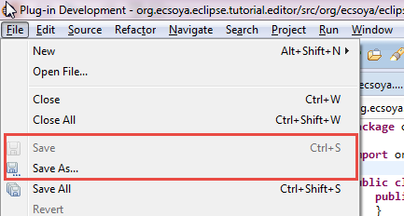

IEditorPart
Save and SaveAs
public void doSave(IProgressMonitor monitor) {
}
public void doSaveAs() {
}
public boolean isDirty() {
return false;
}
public boolean isSaveAsAllowed() {
return false;
}

Slide 9
IEditorInput
public class SampleEditorInput implements IEditorInput {
public Object getAdapter(Class adapter) {
return null;
}
public boolean exists() {
return false;
}
public ImageDescriptor getImageDescriptor() {
return null;
}
public String getName() {
return null;
}
public IPersistableElement getPersistable() {
return null;
}
public String getToolTipText() {
return null;
}
public int hashCode() {
return super.hashCode();
}
public boolean equals(Object obj) {
return super.equals(obj);
}
}
IAdaptable (Platfrom’s adapter manager)
Whether the editor input exists
Returns the image descriptor for this input
Returns the name of this editor input for display purposes
Returns an object that can be used to save the state of this editor input.
Returns the tool tip text for this editor input
The IWorbenchPage.openEditor APIs are dependent on this to find an editor with the same input.

Slide 10
IEditorActionBarContributor
public class SampleEditorActionBarContributor extends EditorActionBarContributor {
public void contributeToCoolBar(ICoolBarManager coolBarManager) {
super.contributeToCoolBar(coolBarManager);
}
public void contributeToMenu(IMenuManager menuManager) {
super.contributeToMenu(menuManager);
}
public void contributeToToolBar(IToolBarManager toolBarManager) {
super.contributeToToolBar(toolBarManager);
}
public void contributeToStatusLine(IStatusLineManager statusLineManager) {
super.contributeToStatusLine(statusLineManager);
}
}

Slide 11
Title And ToolTip
Title
setPartName("Ecsoya - Sample editor");
ToolTip
setTitleToolTip("Welcome to soyatec!");
firePropertyChange(IWorkbenchPart.PROP_TITLE);

Slide 12
Dirty and Save
Is dirty?
Do save
public boolean isDirty() {
// return true if need to save.
return false;
}
public void doSave(IProgressMonitor monitor) {
// Save data of editor.
firePropertyChange(PROP_DIRTY);
}

Slide 13
Opening editor
// Workbench instance from our plugin instance.
IWorkbench workbench = Activator.getDefault().getWorkbench();
// Active window instance.
IWorkbenchWindow activeWorkbenchWindow = workbench.getActiveWorkbenchWindow();
// Active page instance.
IWorkbenchPage activePage = activeWorkbenchWindow.getActivePage();
try {
SampleEditorInput editorInput = new SampleEditorInput();
// Open editor from the editor input and editor ID.
activePage.openEditor(editorInput, SampleEditor.ID); // defined from extension.
} catch (PartInitException e) {
e.printStackTrace();
}

Slide 14
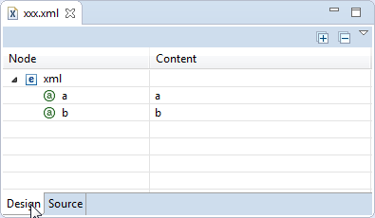
Multiple page editor

Slide 15
MultiPageEditorPart
public class SampleMultiPageEditor extends MultiPageEditorPart {
protected void createPages() {
// add other controls or editors here.
addPage(control);
addPage(editor, input);
}
public void doSave(IProgressMonitor monitor) {
}
public void doSaveAs() {
}
public boolean isSaveAsAllowed() {
return false;
}
}

Slide 16
MultiPageEditorActionBarContributor
public class SampleMultiPageEditorActionBarContributor extends
MultiPageEditorActionBarContributor {
public void setActivePage(IEditorPart activeEditor) {
}
public void contributeToToolBar(IToolBarManager toolBarManager) {
super.contributeToToolBar(toolBarManager);
}
public void contributeToMenu(IMenuManager menuManager) {
super.contributeToMenu(menuManager);
}
}

Slide 17
Outline
Call from editor class
ContentOuline
View
PageBookView
Page
Page
StackLayout
IContentOutlinePage
public Object getAdapter(Class adapter) {
if (IContentOutlinePage.class == adapter) {
return new SampleContentOutlinePage();
}
return super.getAdapter(adapter);
}

Slide 18
Outline
Create outline page
public class SampleContentOutlinePage extends ContentOutlinePage {
private Label control;
public void createControl(Composite parent) {
control = new Label(parent, SWT.NONE);
control.setBackground(parent.getDisplay().getSystemColor(SWT.COLOR_GREEN));
control.setText("Outline for sample editor");
}
public Control getControl() {
return control;
}
public void setFocus() {
control.setFocus();
}
}

Slide 19
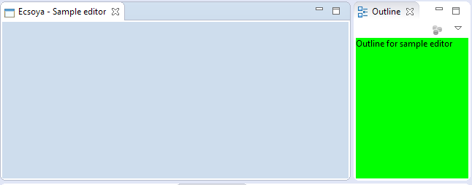
Outline

Slide 20
Any Questions?
Skype: jin.liu.soyatec
Email: jin.liu@soyatec.com

Slide 21
The end

